Slide 1
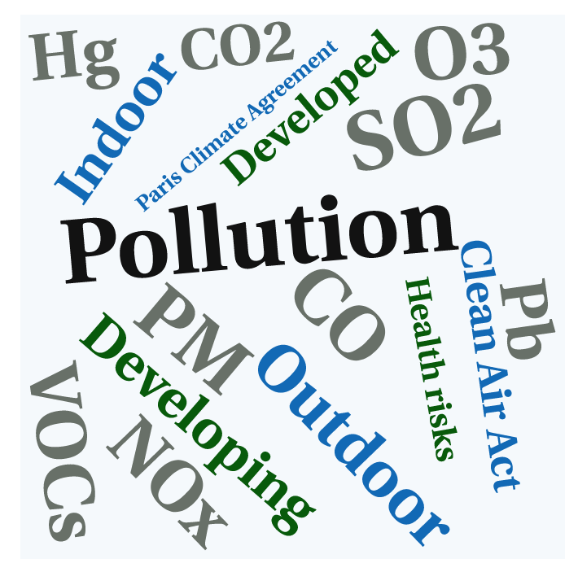
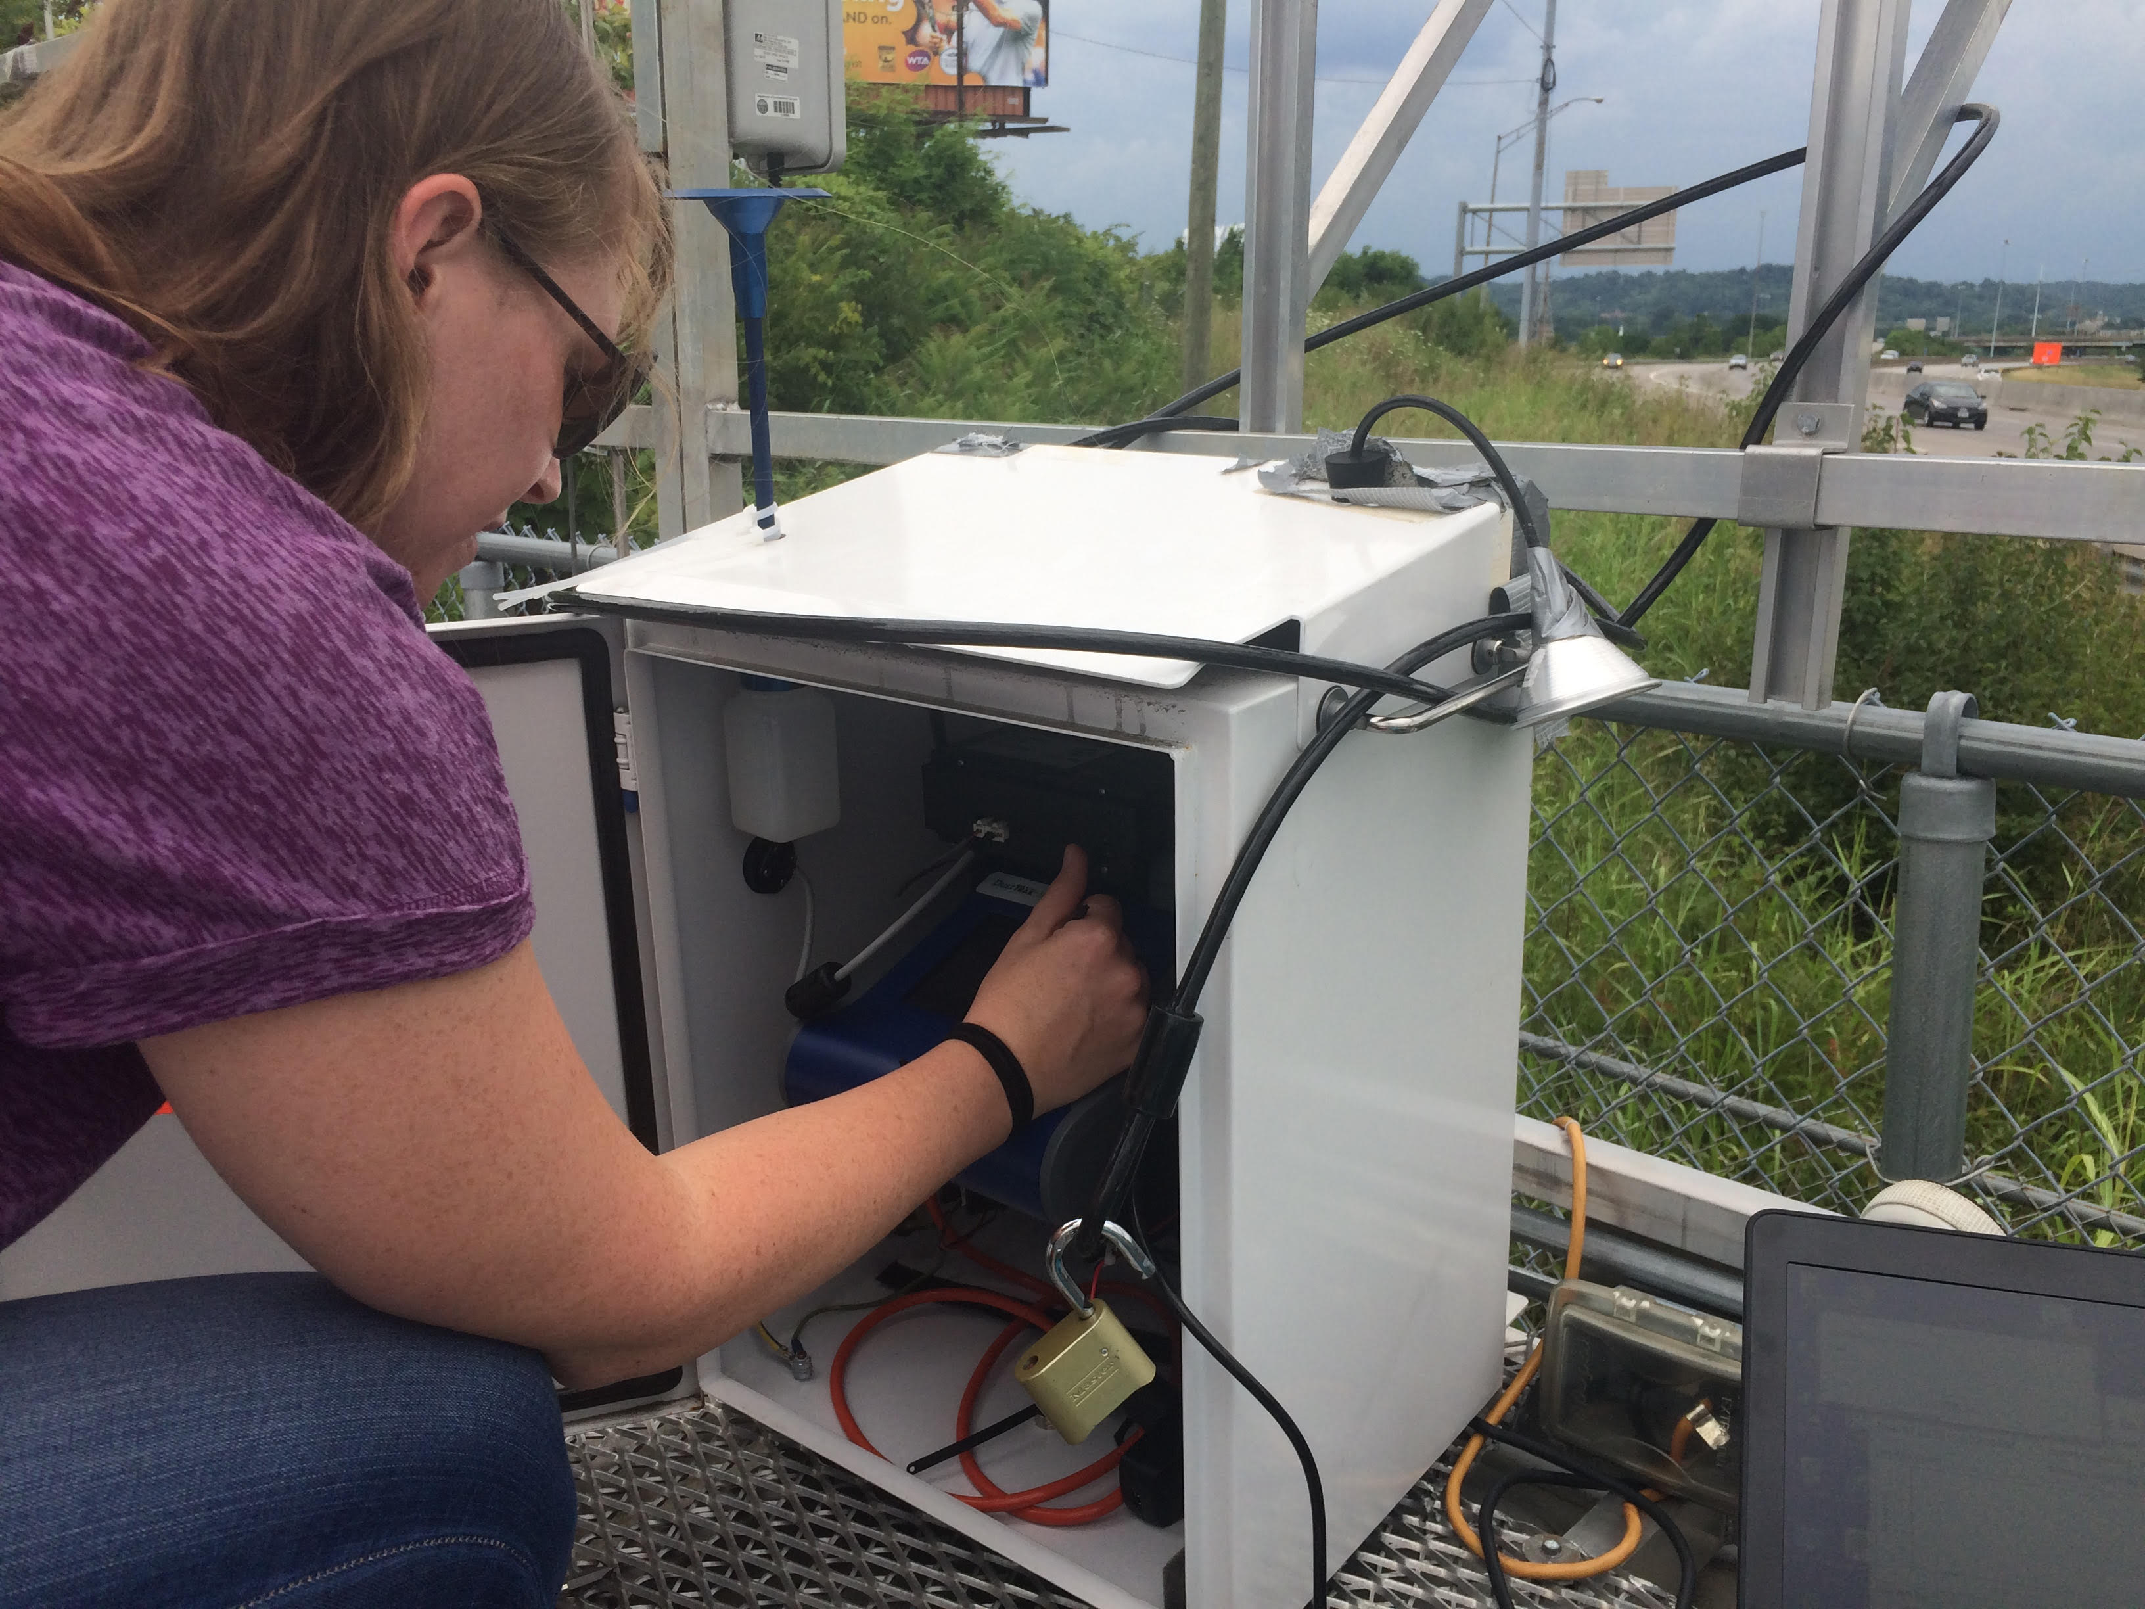
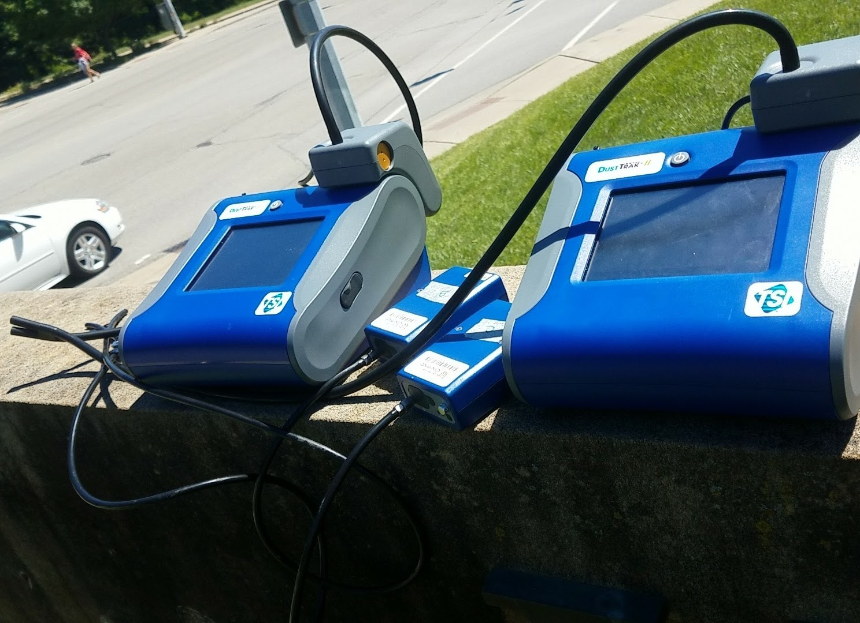
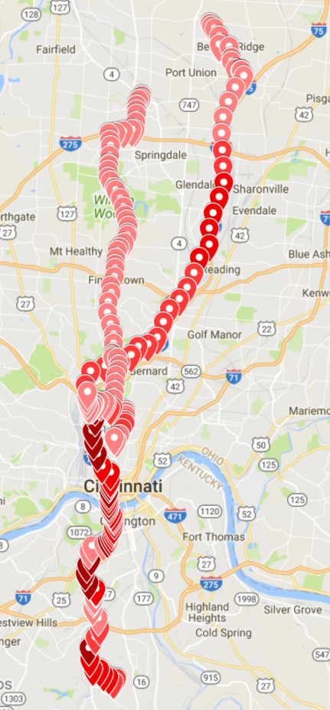
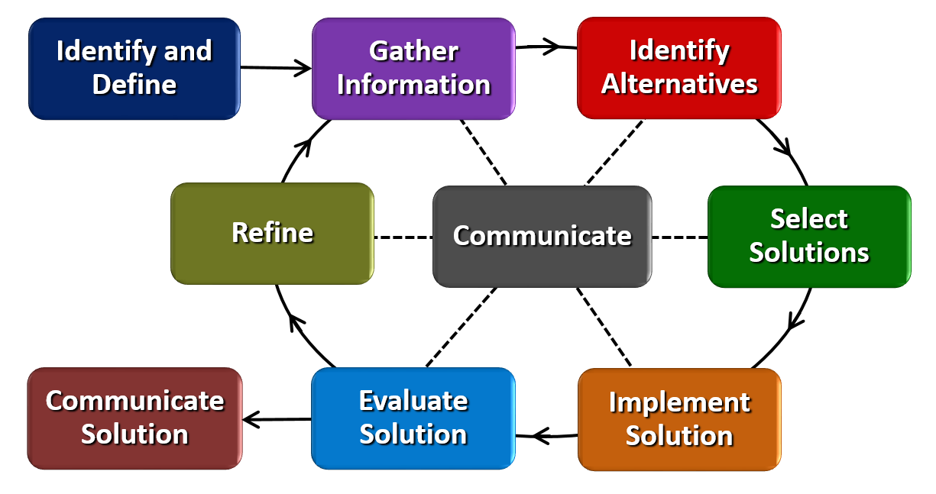
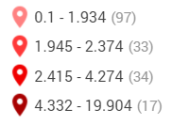
Air Quality Kat Roedig Sickinger The Summit Country Day School 11-12th Grade AP Environmental Science
RET is funded by the National Science Foundation, grant # EEC-1404766
Summer 2017
AP Environmental Science
2017-2018 School Year
Unit 7: Pollution
Research Project: Understanding the Spatiotemporal Variability of Air Pollution (PM_{2.5} & BC) in Microenvironments
Challenge-Based Learning and the Engineering Design Process
Big Idea: Air Pollution and Air Quality
Identify & define a global problem.
Research & gather information about the problem.
Use the research findings to construct a challenge.
PM_{2.5} & BC levels in microenvironments:
Near Roadway site
low-cost vs. professional monitors
Use the engineering design process & materials given to help solve the challenge.
UC’s campus
walking & shuttle bus routes
walking Camp Washington
car commutes
Relevance:
effectiveness of low-cost monitors
life expectancy in Camp Washington vs. Clifton
PM_{2.5} & BC levels in car commutes
https://www.wisetechglobal.com/Portals/WTG/Images/Viewpoints%20&%20PR/Think-Globally-Resized.jpg
http://cdn.publishyourarticles.net/wp-content/uploads/2015/06/Air-Pollution-Could-Cause-Pregnancy-Complications.jpg

